Slide 1
Pre-Live Session
Model Identification for Non-Stationary Model

Slide 2
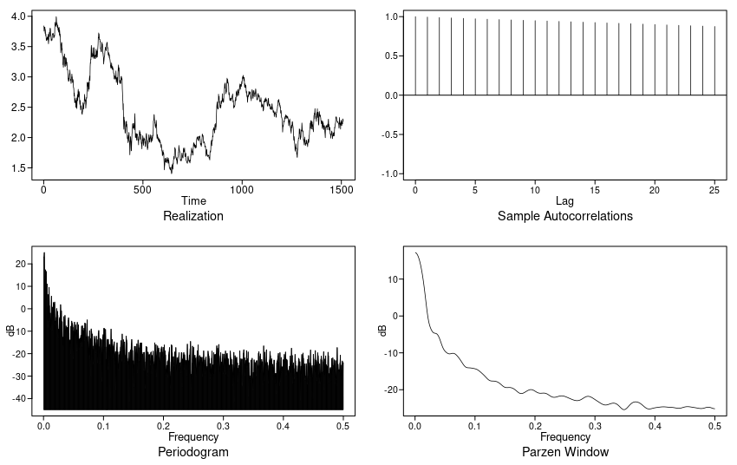
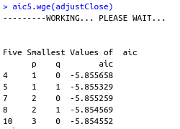
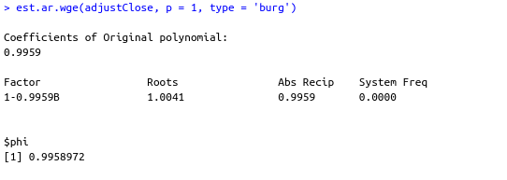
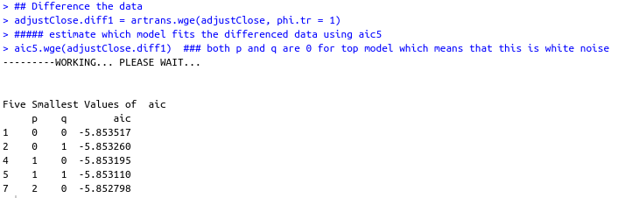
10_year_bond_rate_2010-2015
Has roots inside unit circle so differencing should be applied. 1-B factor is differenced. After differencing white noise remains.

Slide 3
Takeaways
Do not inclue 1-b^12 in model simply because there is 12th order nonstationary or because the data show period of 12. eg sinusoidal data might suggest you to use a different model.
If a higher order AR(p) model fit to a realization from a nonstationary model with roots on the unit circle, then factors associated with these roots will showup in the factor table.
  The stationary behavior will show up in factor tables for a wide range of orders p.
  Fitting several high order models to a set of data to identify nonstationarities is called overfitting.
If we subtract out signal, the residuals which is noise maybe stationary and if stationary may be model as AR, MA or ARMA.
ARIMA model is a process X_t whose difference (1-B)X_t satisfy a stationary ARMA model.
For ARIMA models, phi_1 = 1, the variance of X_T is infinite and thus the autocorrelation are undefined.
The (1-B)^d factor dominates the stationary components in the realizations, autocorrelations, and all spectral densities have peaks at frequency of 0
As d increases the dominance of the actor increases.
Slowly damping sample autocorrelations is an indication of ARIMA data.

